Slide 1
Retro Paradise
an app for the games of the past
Darin McDonald
Jacob White
Lawrence Murillo

Slide 2
What is retro paradise?
Retro Paradise is store that buys and sells old video game consoles and games at a fair price all at the click of a button on your smartphone.
Have you ever thought “Wow, I would really like to get this game I played when I was younger?” well we got you covered.
This app is designed to cater towards retro game fans to help bring back rare/hard to find group of video games.

Slide 3
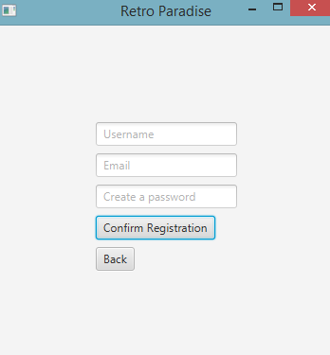
How do I use it?
To use the app for our store you will have to register an account. It’s simple! After providing the information your account will be created and you can login and start shopping. (You don’t need an account to browse!)

Slide 4
Technology used
MariaDB/mySql
Javafx
Netbeans IDE

Slide 5
Okay I’m signed in… now what?
Now that you’ve signed in you can search for anything you want using the browse option when the homepage opens!
There are options to see newly added games. Check your recommendations!

Slide 6
Demonstration
The program starts off in the Java FX GUI application window with three buttons that have the user either “Login”, “Register”, or “Skip sign in”. There is already a preset account in the source code for an admin so I’ll type in “admin” in the username space and password in the “password” space. Of course if any of these fields are blank or incorrect the app will alert me. After signing in the hub will display. Here I can choose between “Browse”, “My Orders”, “Recommendations”, “Cart”, “Settings”, “Customer Service”, “Account” and “Log Out”. If I had chose to skip I wouldn’t be able to access some of these options and would be forced to sign in to an account. I can choose “Browse” and search for items but nothing has any functionality.
Logging out will sign me out of the account and now I will try registering and signing into a new account. All fields must have something in them and once you’re done it will display your info back to you and you should be able to sign in.
That’s all there is to the Retro Paradise app at this time.

Slide 7


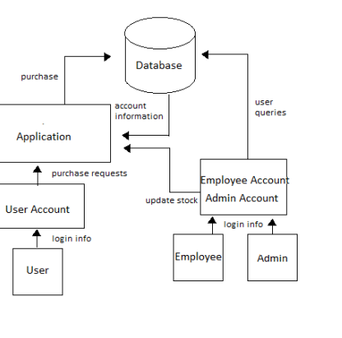
Diagram 0

Slide 8
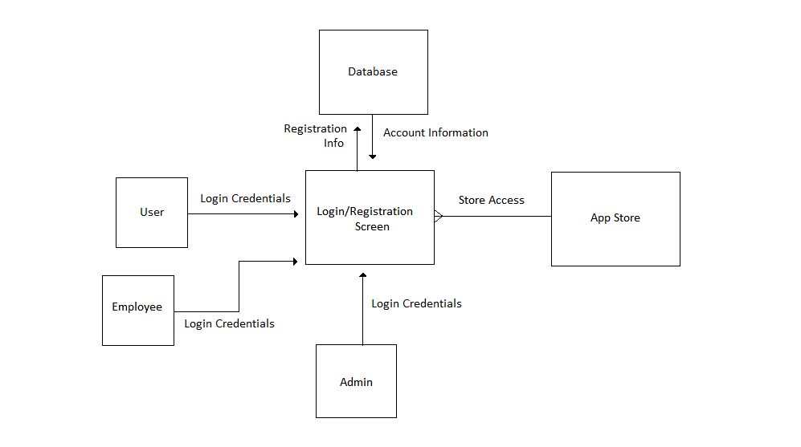
Context diagram

Slide 9
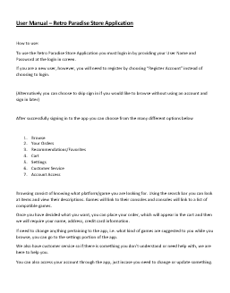
Still need help with the app?
There’s a user manual for anyone that needs further assistance with using and navigating our app!

Slide 10
Moving forward
With additional time and effort we hope to grow this app from what it is now to something much greater. Many more updates that allow more functionality and of course anything else we can do to make sure this app grows.
Connecting the app to the database is one such key feature that needs to implemented because a majority of the menus and features of the app rely on it.

Slide 11
Thank You!

